Slide 1
SM5033 - Internet of Things
Final Project Report
Topic : Optimizing B - Spline curves for robot navigation
Supervisor : Dr. P. Rajyalakshmi
TA : Sanju Kumar Name : Kodavanti Rama Sravanth

Slide 2
Problem Statement & Solution
Problem : Robots need to have a definite path from start to finish without hitting the obstacles in the middle . They have sensors to predict the location of obstacles around them.
Solution : We create B Spline Curves , which are smooth curves there by giving a smooth navigation from start to finish . We then refine the navigation algorithm in further iterations depending on upon the situation
Advantages of choosing B Spline curves in navigation are 1. They are smooth , there by not damaging wear & tear of the mechanical parts of the robot. 2. Changing the position of local control point does not affect The entire path.

Slide 3
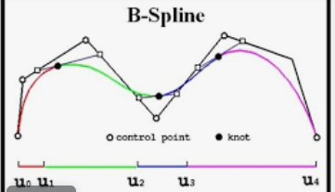
What are B Spline Curves

Slide 4
Work done till now - Stage 1
Research on what is B - Spline ( Basis Spline ) Curves , Path Planning.
Learned about ROS - which is a middleware framework used for robotic applications , Gazebo - which is robot simulation environment.
Implemented Gazebo Navigation Stack github , the work involves navigating the robot whose goal is to travel in a maze which is having obstacles in the middle.

Slide 5
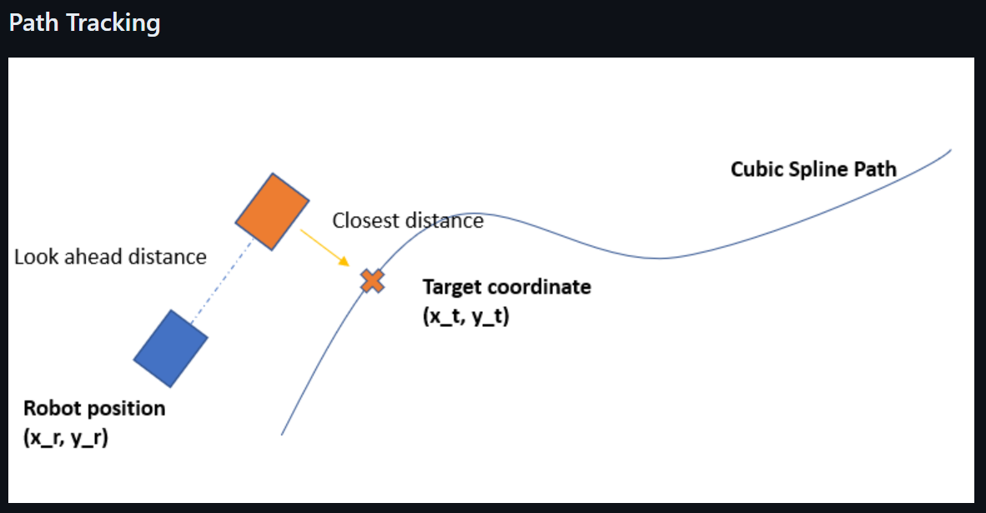
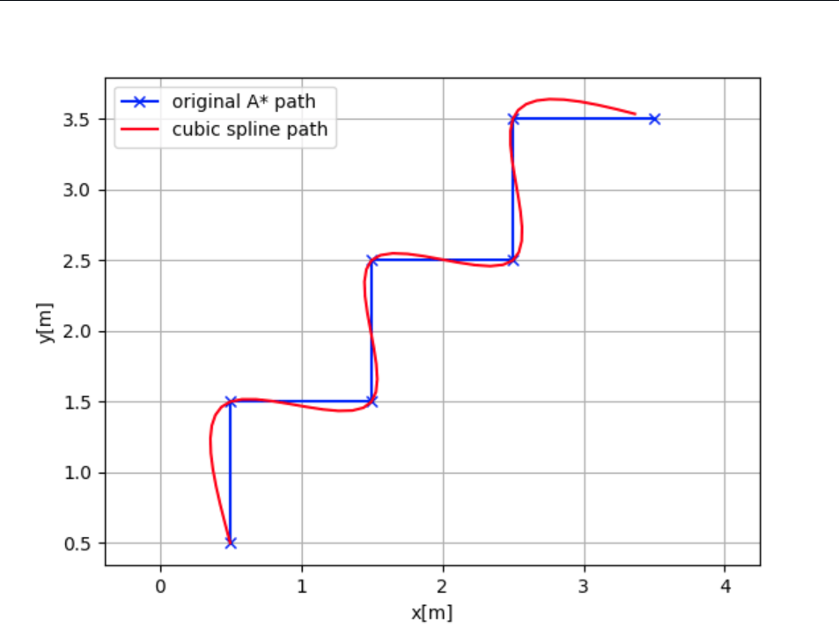
Work done till now - Stage 1 - Results

Slide 6
Work done till now - Stage 2
There is ongoing work on navigation of robot using B - Spline curves by Sanju sir, He is optimizing the path for the better journey of robot from start to finish.
So, I initially tried to understand the code provided by him.
I have increased the number of control points of the b spline curves. With the increase of control points we have more command on the path of the robot.

Slide 7
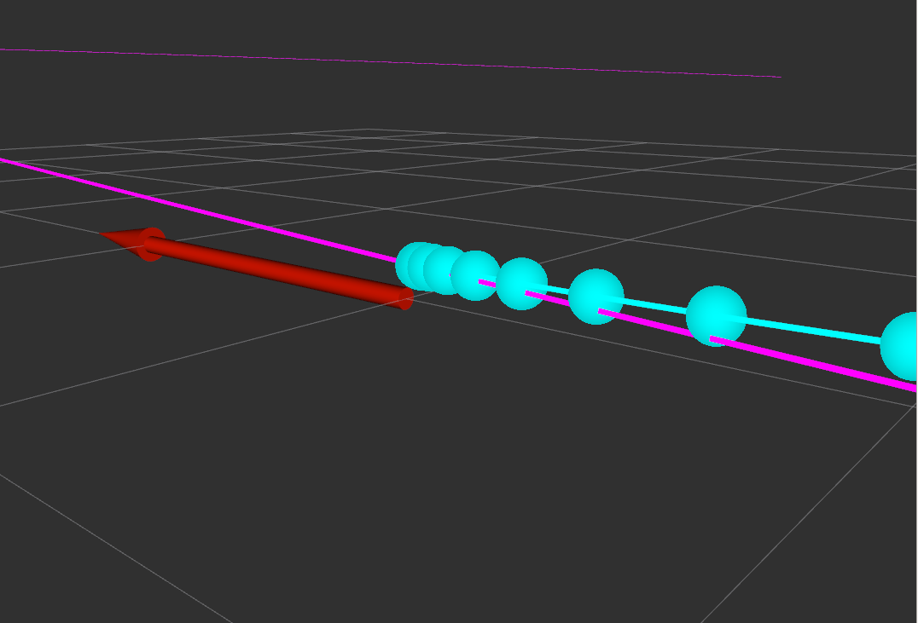
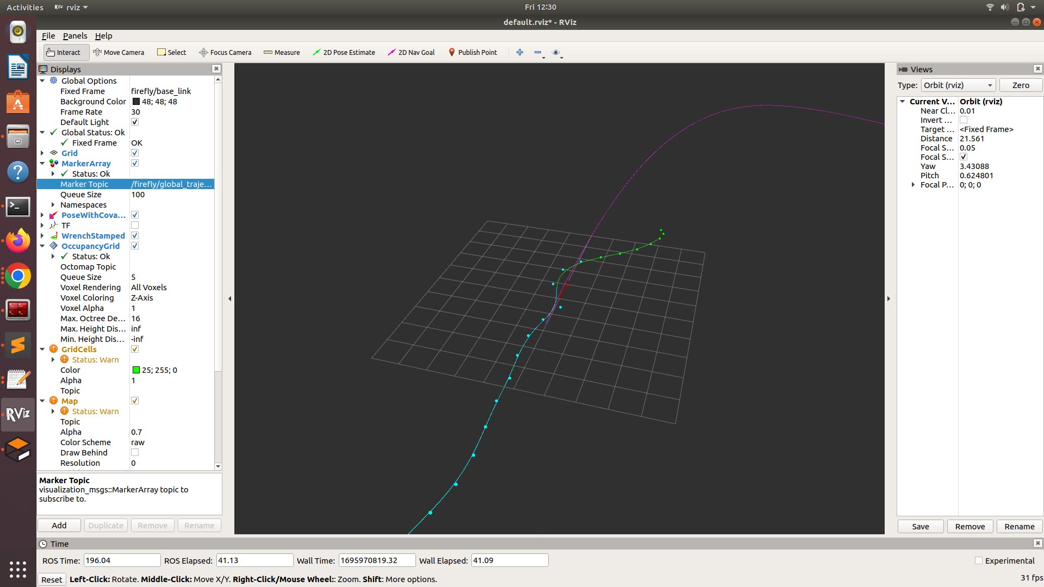
Work done till now - Stage 2 - Results
০ is for global path , ০ is for path taken till now & ০ is for the future path given by algorithm.

Slide 8
Work done till now - Stage 2
Implemented UAV - Motion - Control github ,This is for trajectory generation for a given ground truth path under the condition of no obstacles
Goal is to match the generated trajectory with that of ground truth.
What we got is by having high peaks or curves with less radius of curvature in the trajectory will result in a large jerk on the drone that of the curve with more radius of curvature.

Slide 9
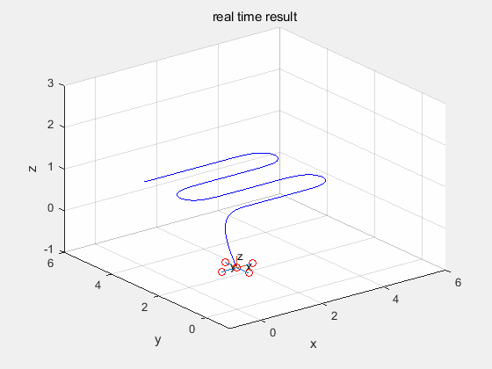
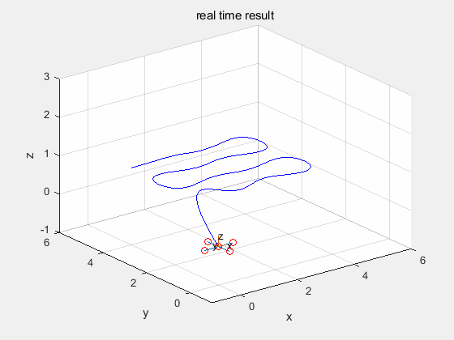
Work done till now - Stage 2 - Results
Results of the implementation are as follows :

Slide 10
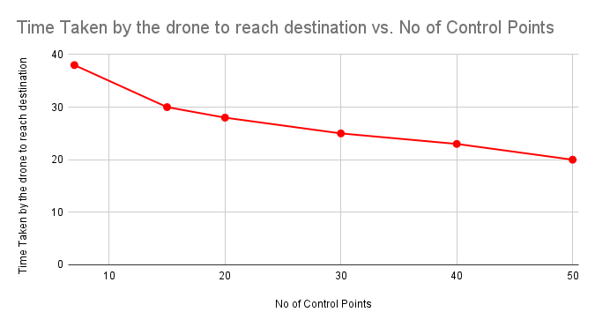
Work done till now - Stage 3
Experimented with the number of control points on the drone journey. Found that with increase in number of control points time taken for the drone to reach the destination decreases.

Slide 11
Work done till now - Stage 3 - Results
No of Control Points | Time Taken by the drone to reach destination | Value of dt | Time Taken for the drone to start
7 | 38 sec | 0.5 | 7 sec
15 | 30 sec | 0.5 | 9 se
20 | 28 sec | 0.5 | 10 sec
30 | 25 sec | 0.5 | 13 sec
40 | 23 sec | 0.5 | 15 sec
50 | 20 sec | 0.5 | 20 sec

Slide 12

Stage 3 - Comparison of Trajectory with control points

Slide 13
Stage 3 - Variation of trajectory with velocity gains
Experimented with velocity gains of the drone, observed the change in drone trajectory with the velocity gains.
Velocity Increment | Time Taken by the drone to reach destination | Value of dt
2 | 27.3 sec | 0.5
5 | 24 sec | 0.5
7 | 20 sec | 0.5

Slide 14
Stage 3 - Failures for Velocity Increment
Observed that after velocity increment, the drone is crashing in the middle & it is not reaching the destination.

Slide 15
Stage 3 - Drone Trajectory with dynamic obstacles
Helped Sanju sir, for algorithm implementation of trajectory planning when dynamic obstacle was present in the trajectory.

Slide 16
Future Works & Improvements
Tuning the path planning algorithm such that it can high speeds without crashing & also speed decrement implementation near the obstacles.
Comparing the performance of taking LIDAR sensor instead of CAMERA.

Slide 17
Acknowledgement & Learnings
I really thank Sanju sir for helping me the project . He had given proper guidance for the improvement of the project
I had learned a lot about ROS , Gazebo , MAVROS & drone trajectory planning using B spline curves.

Slide 18
References
Gazebo Navigation Stack
Gazebo - Installation
ROS - Gazebo - Spline - Path - Planning - Code

